Slide 1



hospital records
View in Power BI
Last data refresh:
7/11/2022 10:50:30 AM UTC
Downloaded at:
7/11/2022 11:50:47 AM UTC

Slide 2
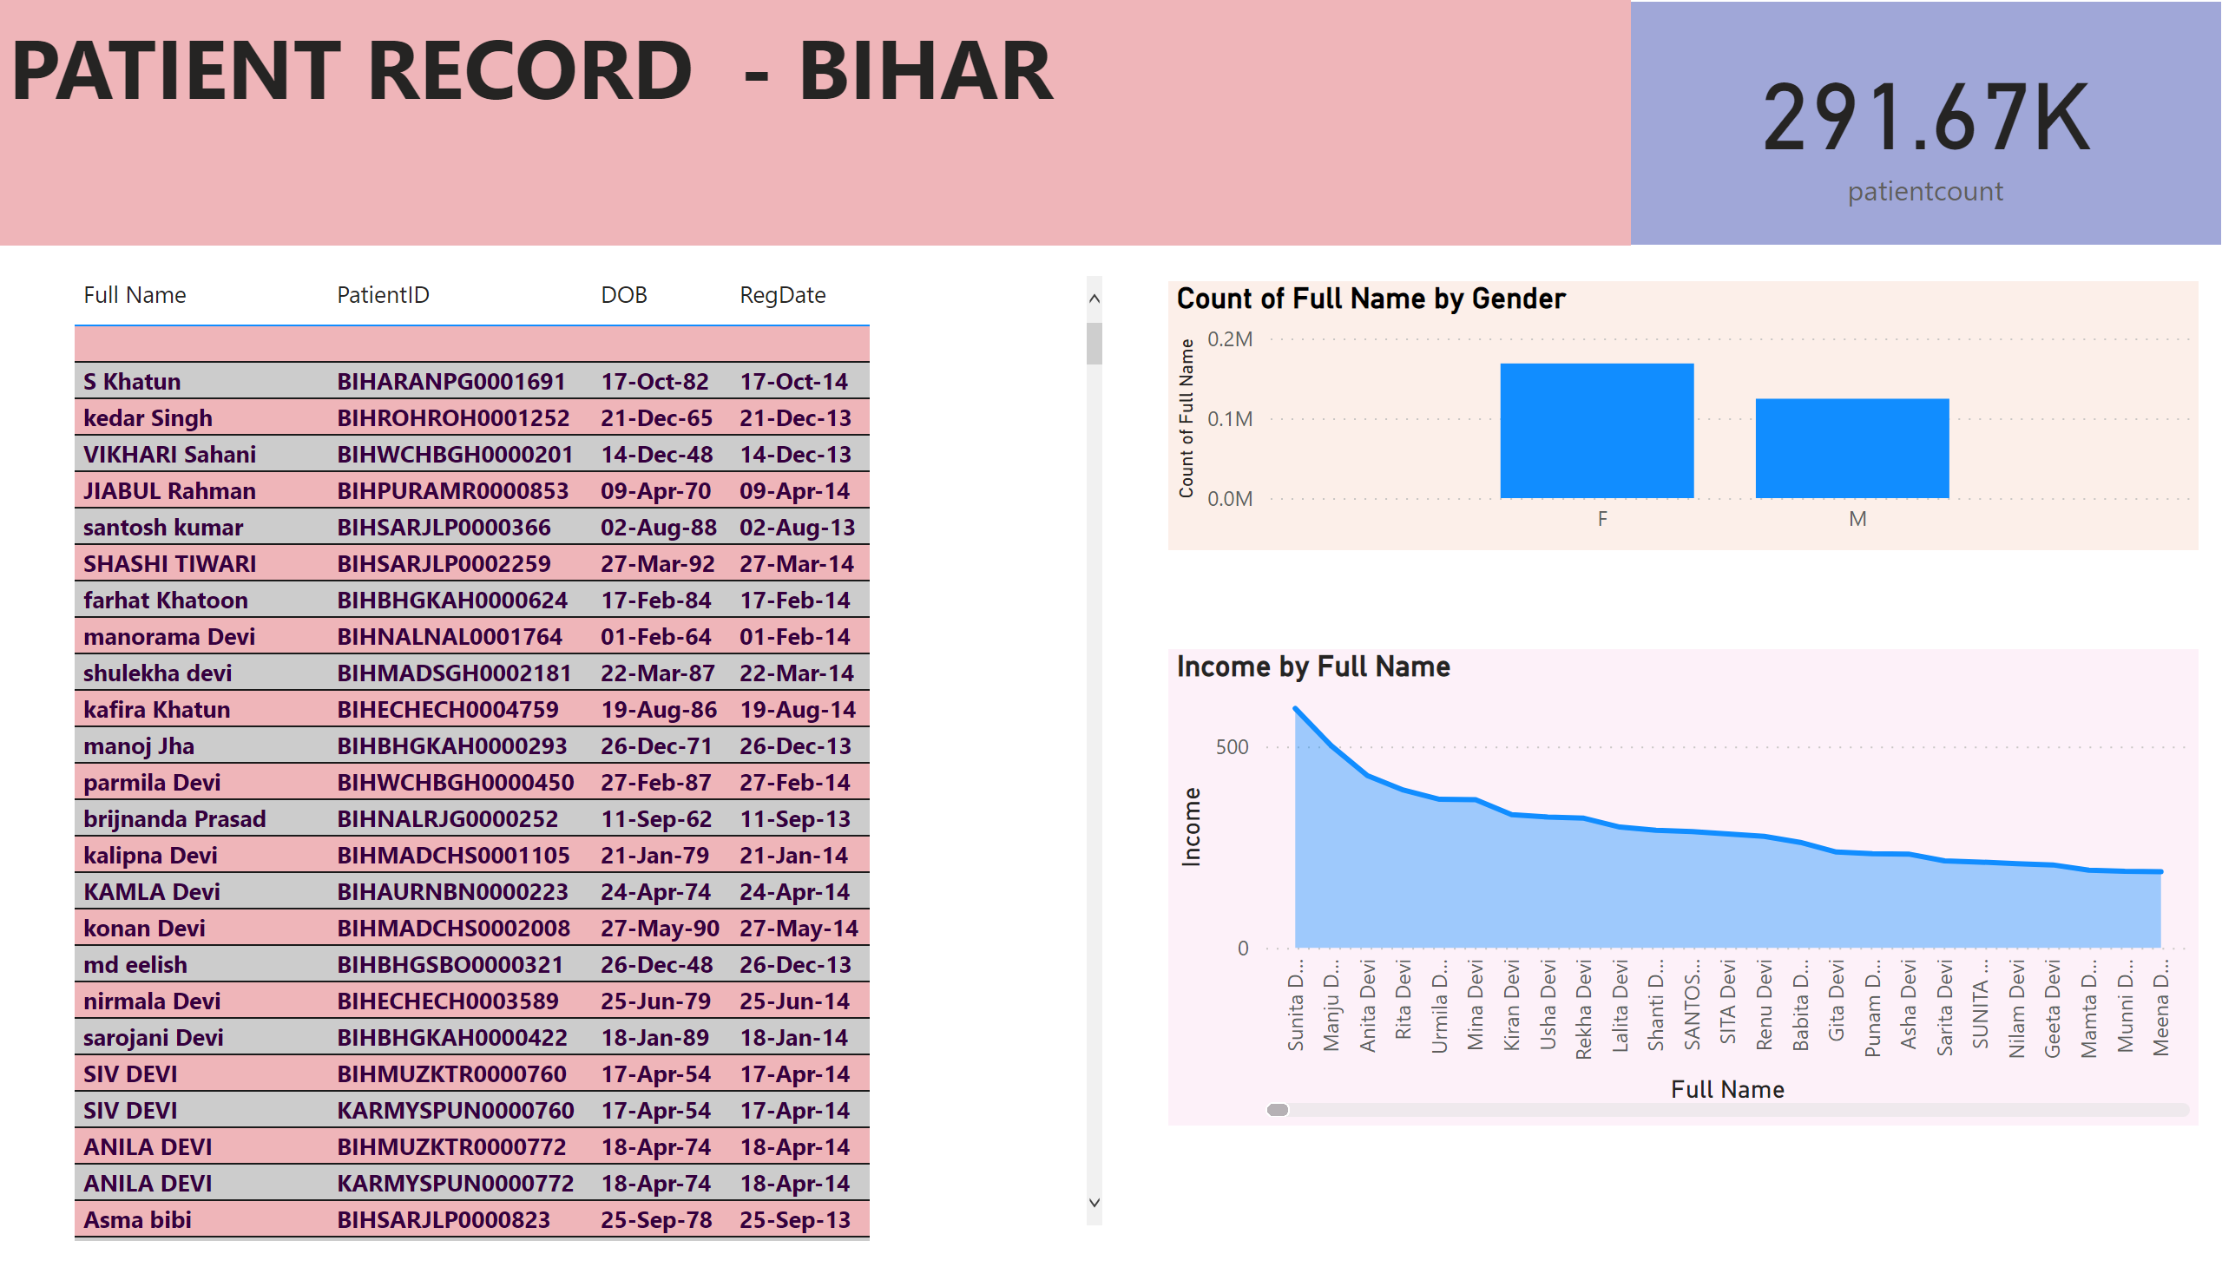
Page 1
Notes:
areaChart
No alt text provided
card
No alt text provided
columnChart
No alt text provided
tableEx
No alt text provided
textbox
No alt text provided

Slide 3
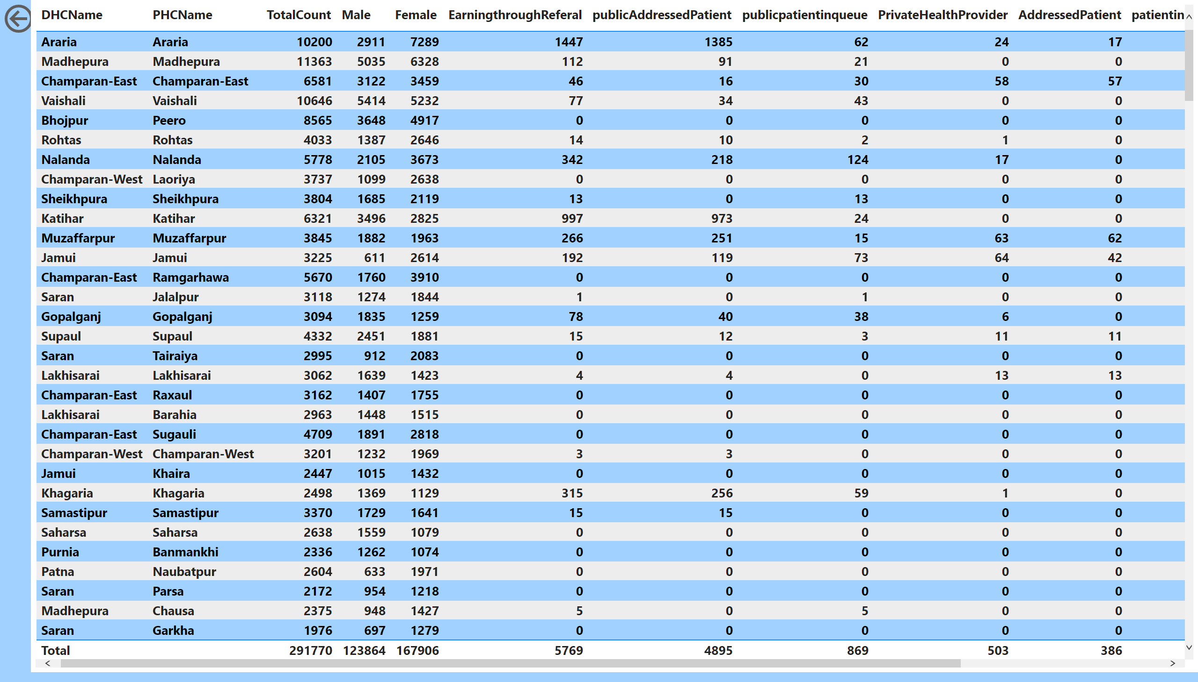
Page 2
Notes:
actionButton
No alt text provided
tableEx
No alt text provided

Slide 4
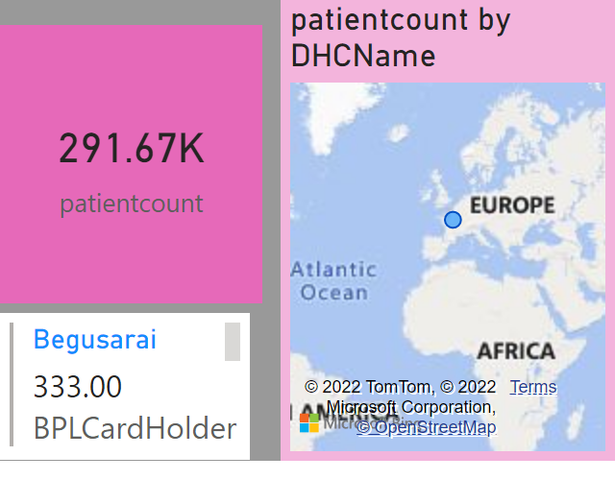
Page 3
Notes:
card
No alt text provided
map
No alt text provided
multiRowCard
No alt text provided

Slide 5
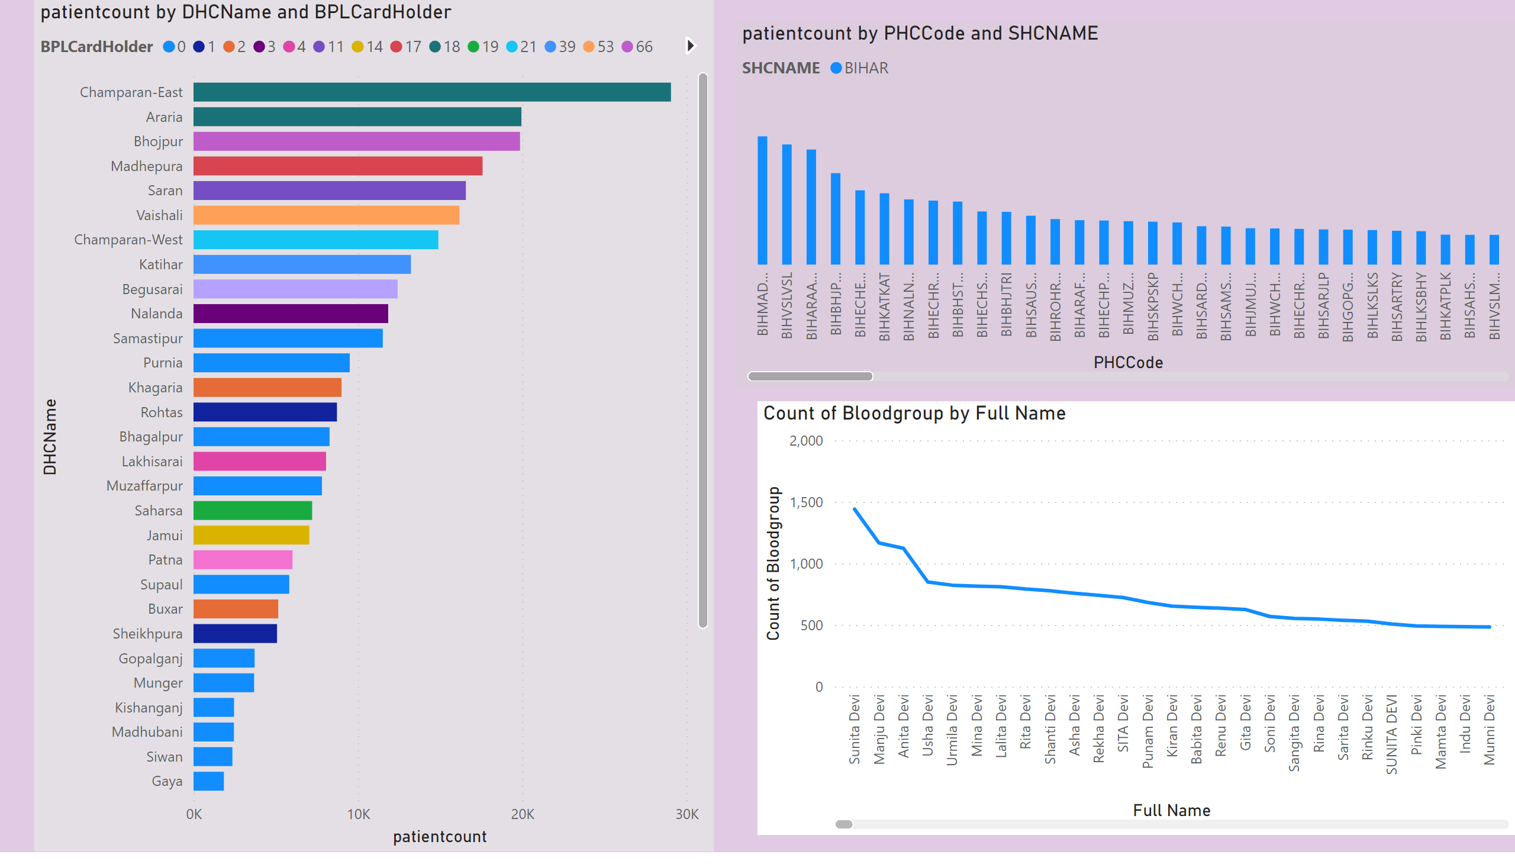
Page 4
Notes:
barChart
No alt text provided
ribbonChart
No alt text provided
lineChart
No alt text provided

Slide 6
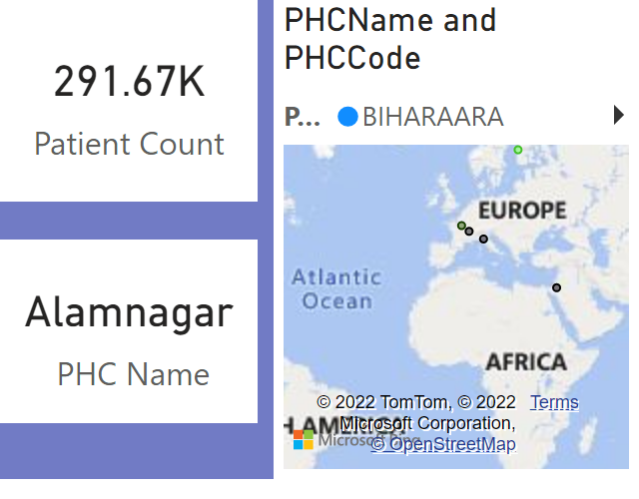
Page 6
Notes:
card
No alt text provided
map
No alt text provided
card
No alt text provided

Slide 7
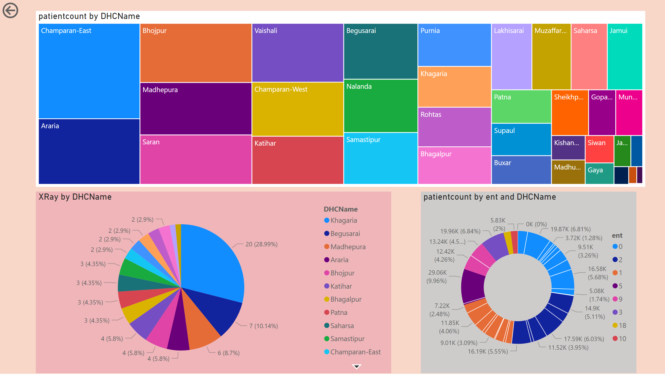
Page 5
Notes:
actionButton
No alt text provided
treemap
No alt text provided
donutChart
No alt text provided
pieChart
No alt text provided

Slide 8
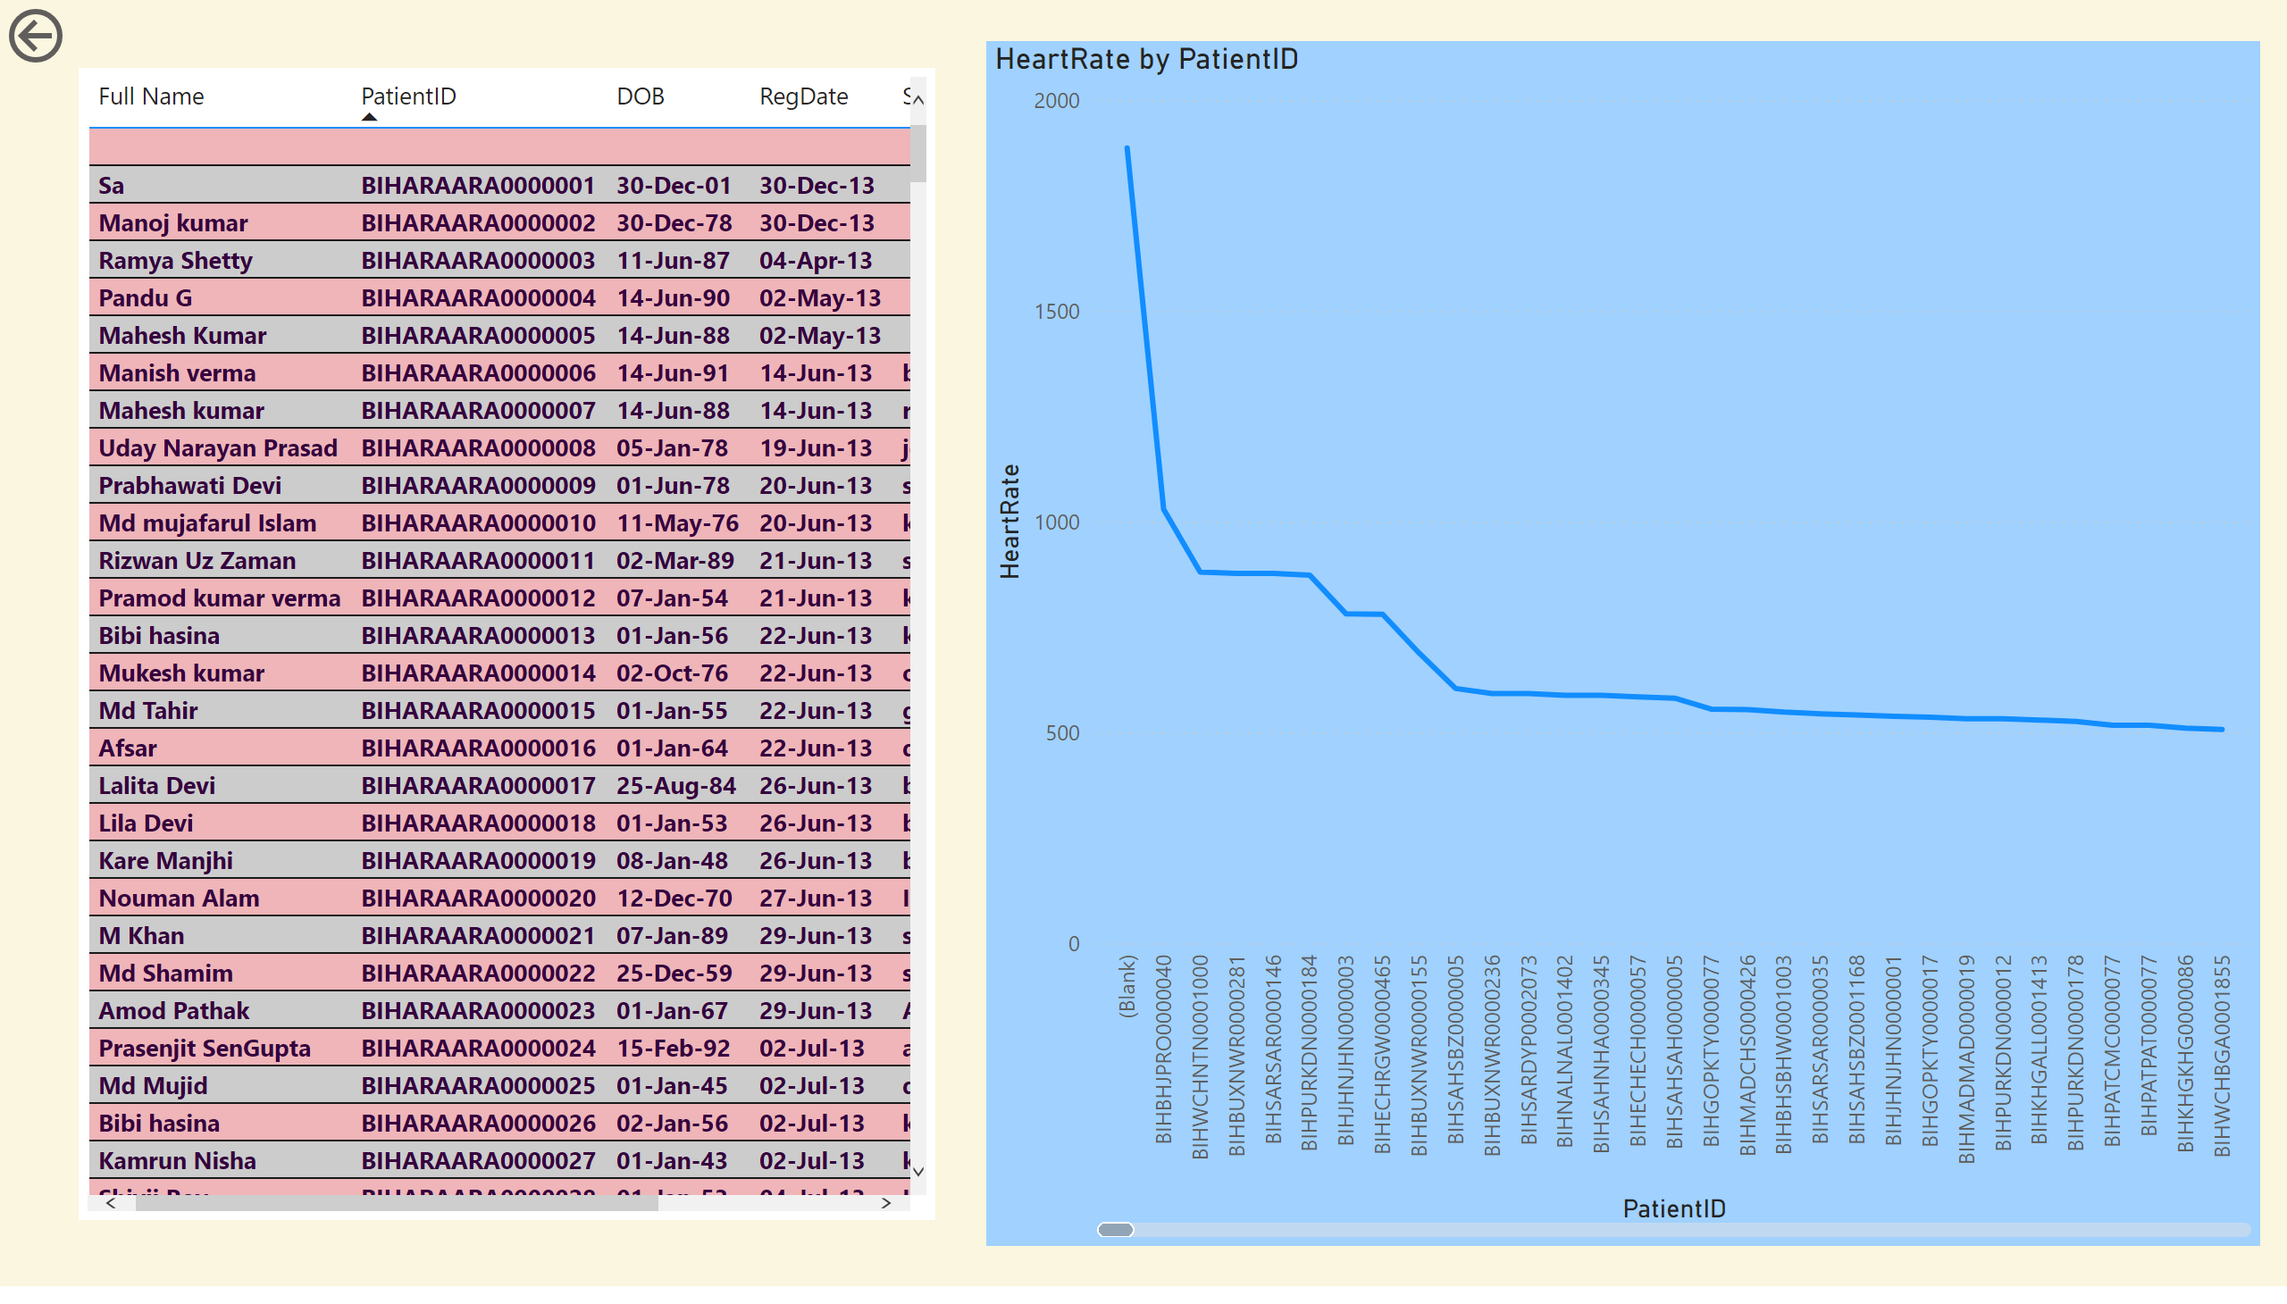
Page 7
Notes:
lineChart
No alt text provided
tableEx
No alt text provided
actionButton
No alt text provided

Slide 9
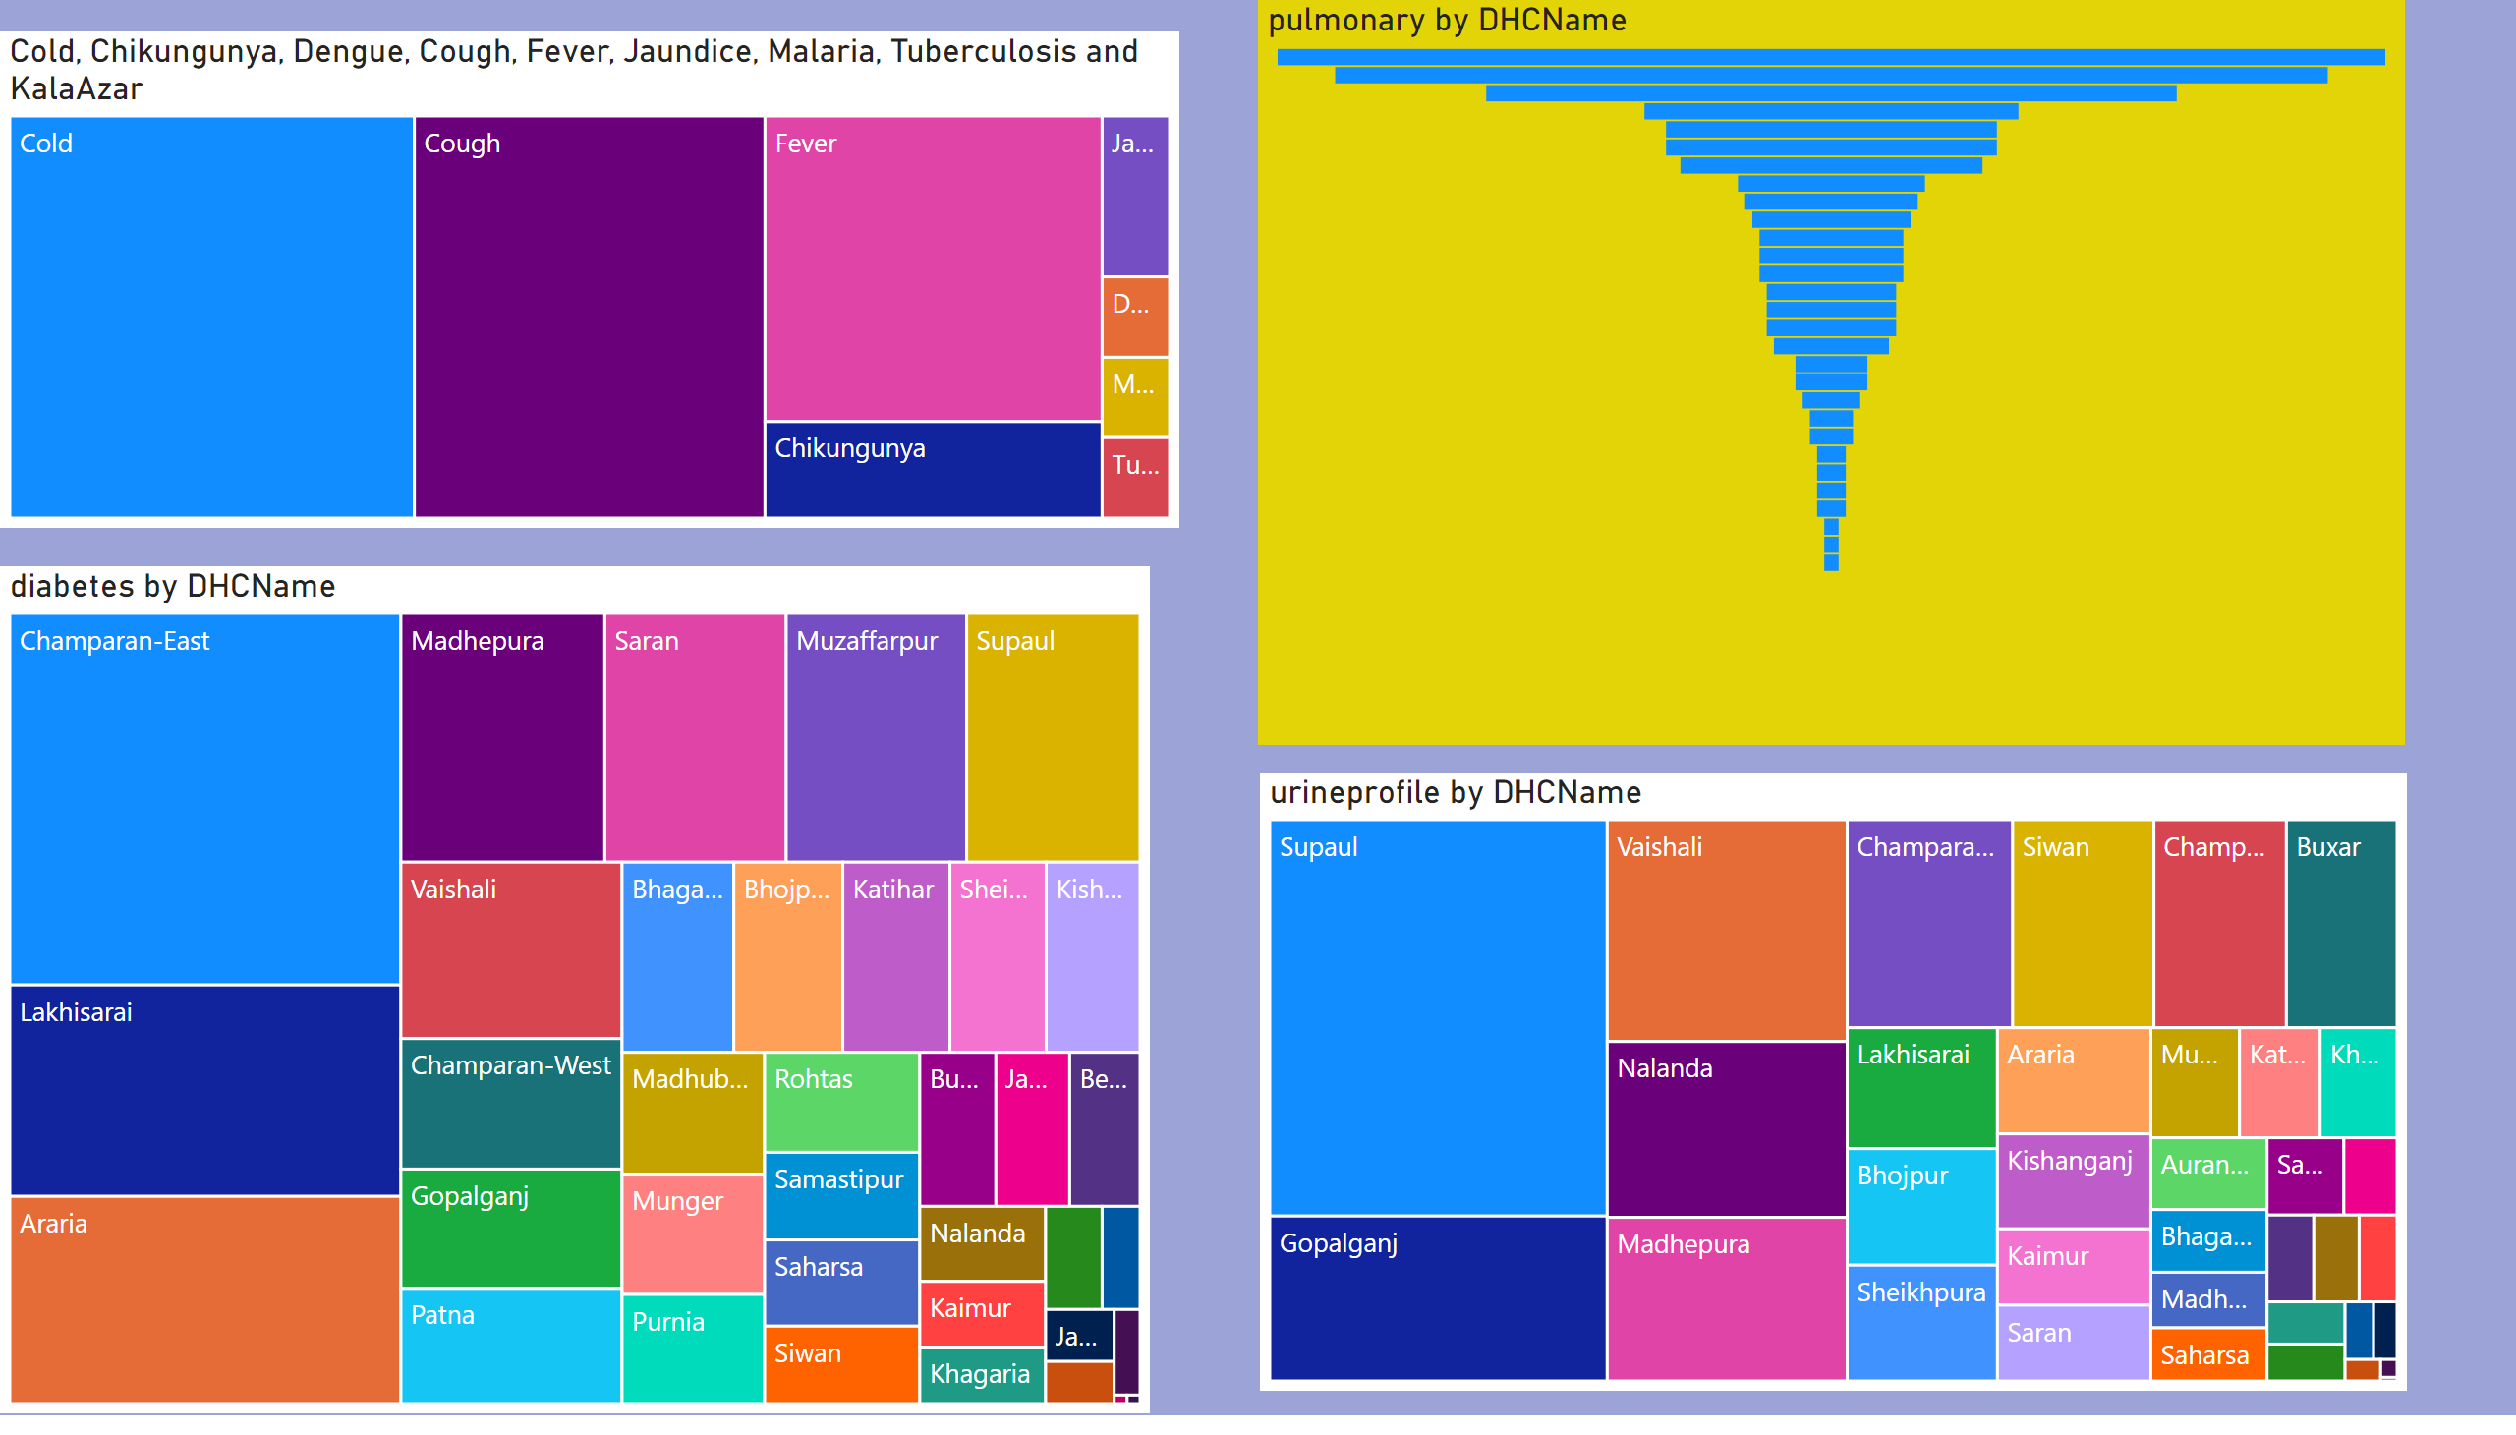
Page 8
Notes:
treemap
No alt text provided
treemap
No alt text provided
funnel
No alt text provided
treemap
No alt text provided

Slide 10
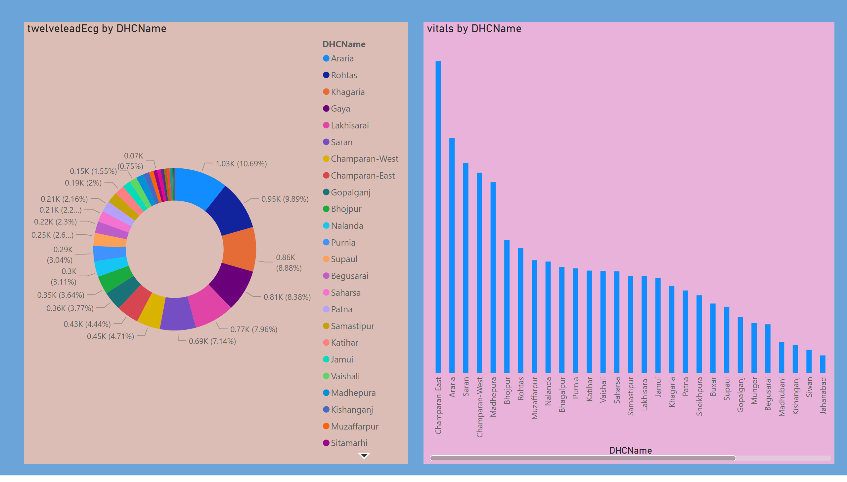
Page 9
Notes:
donutChart
No alt text provided
ribbonChart
No alt text provided

Slide 11
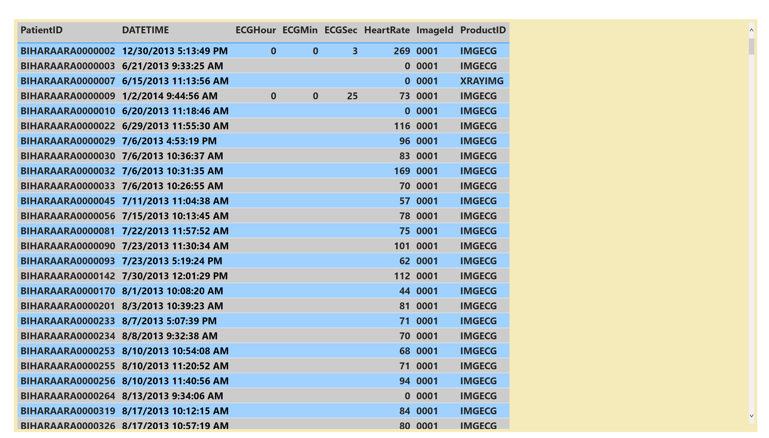
Page 10
Notes:
tableEx
No alt text provided

Slide 12
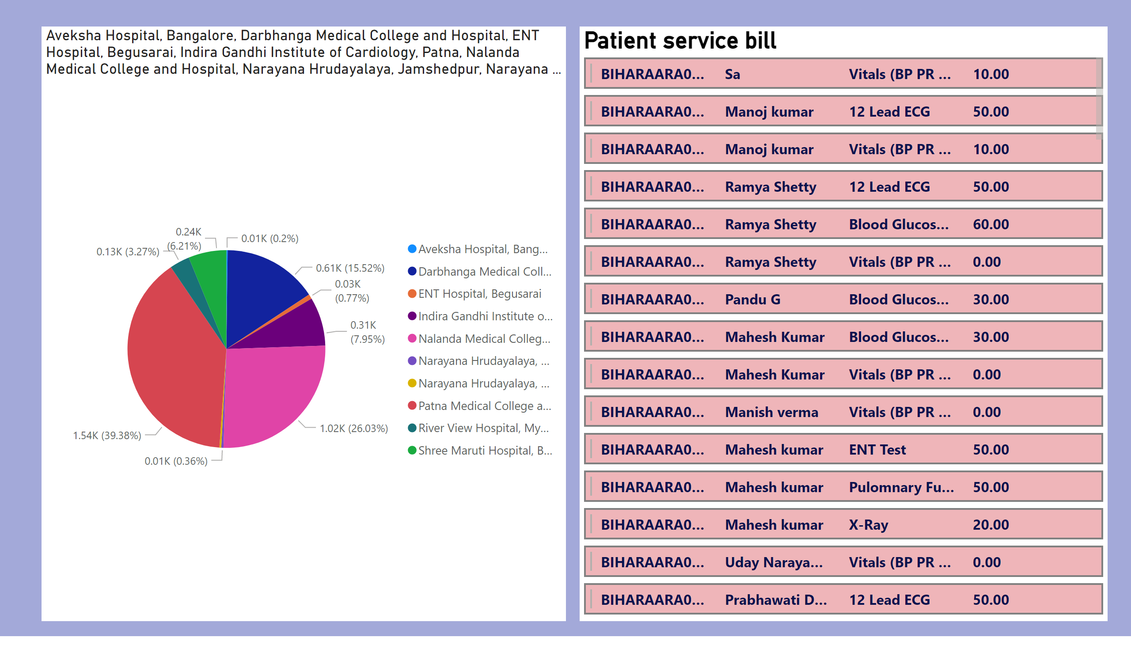
Page 11
Notes:
pieChart
No alt text provided
Patient service bill
No alt text provided

Slide 13
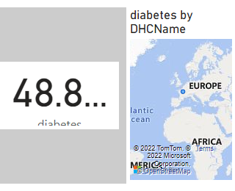
Page 12
Notes:
card
No alt text provided
map
No alt text provided

